Slide 1
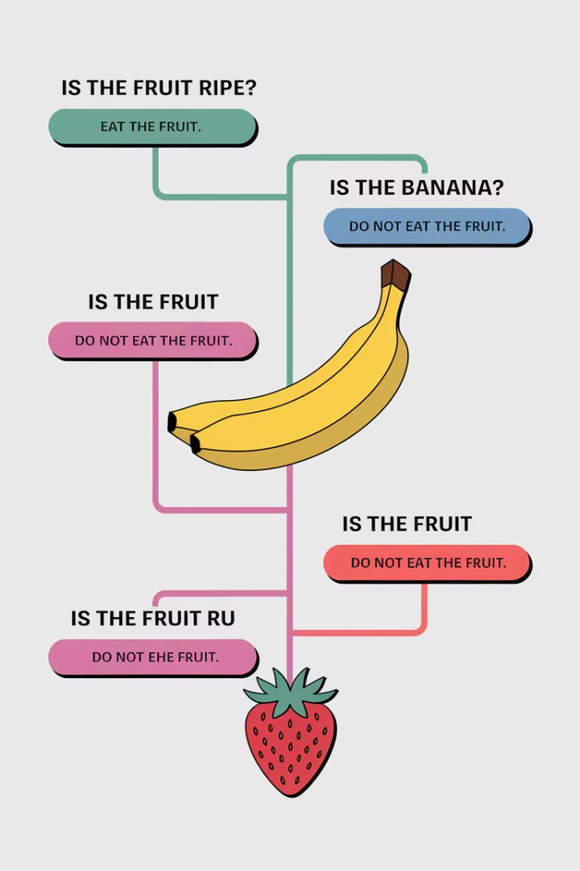

Understanding Decision Trees: A Visual Guide to Smart Decisions
Decision trees are simple diagrams showing choices and their possible outcomes. They help you make decisions easily through visual representations of options.

Slide 2

What is a Decision Tree?
Visual Decision Tool
Hierarchical Structure
A graphical representation of different options for solving a problem.
Starts with one main question at the top and branches into different possible outcomes.
Relationship Mapping
Shows how different factors are related and influence the final decision.

Slide 3

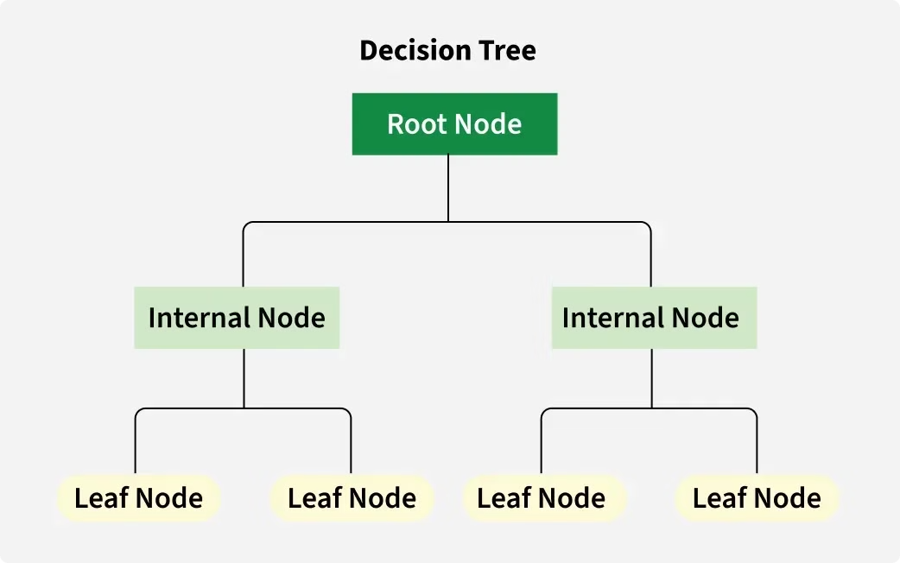
Decision Tree Structure
1
Root Node
The starting point representing the entire dataset.
2
Branches
Lines connecting nodes, showing flow from one decision to another.
3
Internal Nodes
Points where decisions are made based on input features.
4
Leaf Nodes
Terminal nodes representing final outcomes or predictions.

Slide 4




Visualizing Decisions
Evaluate Options
Decision trees support decision-making by visualizing potential outcomes.
Compare Branches
Quickly evaluate different paths to determine the best course of action.
See Consequences
View potential results of each decision before making a choice.

Slide 5

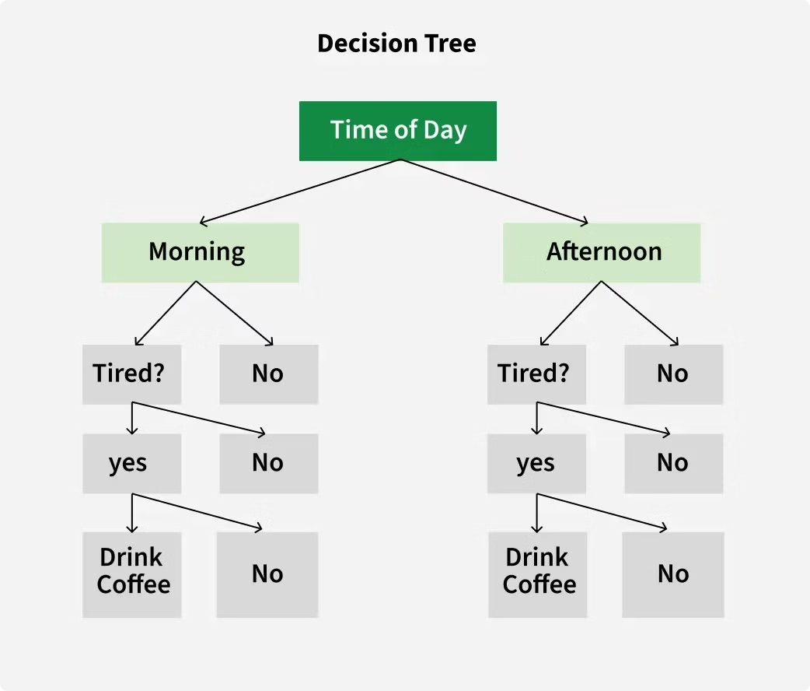
Real-World Example: Coffee Decision
1
Morning Check
First, the tree checks if it's morning.
2
Tiredness Level
Then, it asks whether you are tired.
3
Make Decision
If tired, drink coffee. If not, no coffee needed.
4
Afternoon Analysis
Similar process repeats for afternoon decisions.

Slide 6
Types of Decision Trees
Classification Trees
Regression Trees
Designed to predict categorical outcomes. They classify data into different classes like "spam" or "not spam" emails.
Used when the target variable is continuous. They predict numerical values such as house prices based on features.

Slide 7



How Decision Trees Work: Starting Point
Initial Question
2
First decision point that serves as the starting point.
Root Node
1
Begins with a main question derived from dataset features.
Dataset Division
3
Splits the entire dataset into initial categories.

Slide 8

How Decision Trees Work: The Process
Ask Yes/No Questions
Series of questions designed to split data into subsets based on attributes.
Follow Branches
Different responses lead down different paths in the tree.
Continue Branching
Process repeats, breaking data into smaller, more specific groups.
Reach Conclusion
End at a leaf node with the final outcome or prediction.

Slide 9





Advantages of Decision Trees
Simplicity
Versatility
No Feature Scaling
Non-linear Relationships
Straightforward and easy to understand like a flowchart.
Can be used for both classification and regression tasks.
Don't require normalizing or scaling your data.
Capable of capturing complex relationships between variables.

Slide 10



Disadvantages of Decision Trees
Overfitting
1
Captures noise in training data
Instability
2
Small input changes cause big prediction differences
Bias Issues
3
Can overemphasize features with many categories

Slide 11

Application: Banking
1
4
Loan Approval
Input Features
Banks use decision trees to evaluate loan applications based on customer profiles.
Income, credit score, employment status, and loan history inform the decision.
2
Outcomes
The tree predicts approval or rejection, enabling quick, reliable decisions.

Slide 12




Application: Healthcare
Medical Diagnosis
1
2
Clinical Data
Predicting whether a patient has a specific condition like diabetes.
Uses features like glucose levels, BMI, and blood pressure.
Treatment Planning
Patient Classification
Helps determine appropriate care based on predicted outcomes.
4
3
Tree categorizes patients to assist doctors in diagnosis.

Slide 13
Application: Education
Student Success Prediction
1
Forecasting pass/fail outcomes
Input Data Collection
2
Attendance, study time, previous grades
At-Risk Identification
3
Targeting students needing support

Slide 14



Building Effective Decision Trees
Prevent Overfitting
Balance Features
Validate Results
Prune your tree to remove unnecessary branches that might cause overfitting.
Ensure all important features are considered without bias toward any particular one.
Test your decision tree with new data to ensure accuracy and reliability.

Slide 15

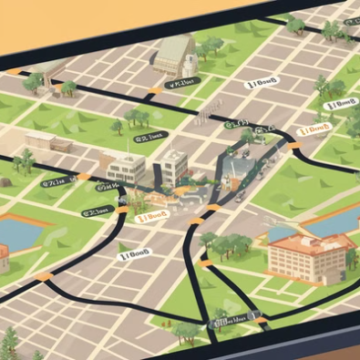


Decision Trees in Our Daily Lives
We use decision trees in everyday life—choosing clothes based on weather, selecting routes when driving, deciding what to buy online, or picking meals at restaurants.

